Slide 1

Bangladesh Army University of Science & Technology (BAUST), Saidpur
Department : Computer Science & Engineering
Course Code : CSE 2200
Course Title : Software Development Project II
Submitted By :
Submitted To :
Student Name : MD. Sabbir Ahmed
ID : 180201071
Level : 2 Term : II
Section :B
Date of Submission : 29/11/2020
Teacher Name :
MD. Toukir Ahmed
Designation : Lecturer
Project Name: Friends Zone App Page: 01

Slide 2
Proposed Project
Friends zone app using android studio
Project Name: LUDO Game Page: 02

Slide 3
Objective
It will help to communicate with one another . Any one can do video call very easily. It will reduce the traffic and redundncy .Simply management and usability
Project Name: Friends Zone App Page: 03

Slide 4
Use apparatus for the project
Windows 10 operating system
Android studio
I also get some help from:
www.youtube.com
www.code-projects.org
www.codesource.com
Project Name: Friends Zone App Page: 04

Slide 5
Important parts of program
I make some part of the program:
Project Name: Friends Zone App Page: 05

Slide 6
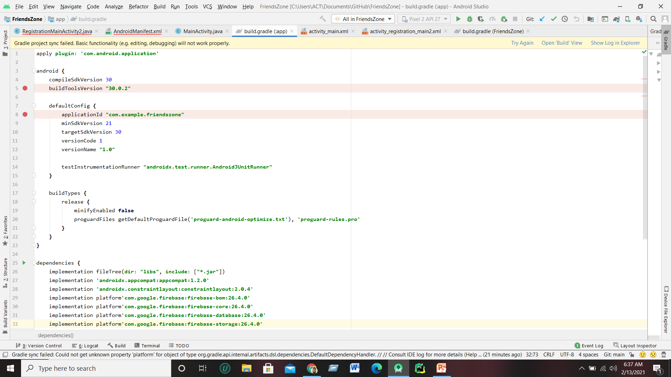
Important parts of program
Build.gradle
Project Name: Friends Zone App Page: 06

Slide 7
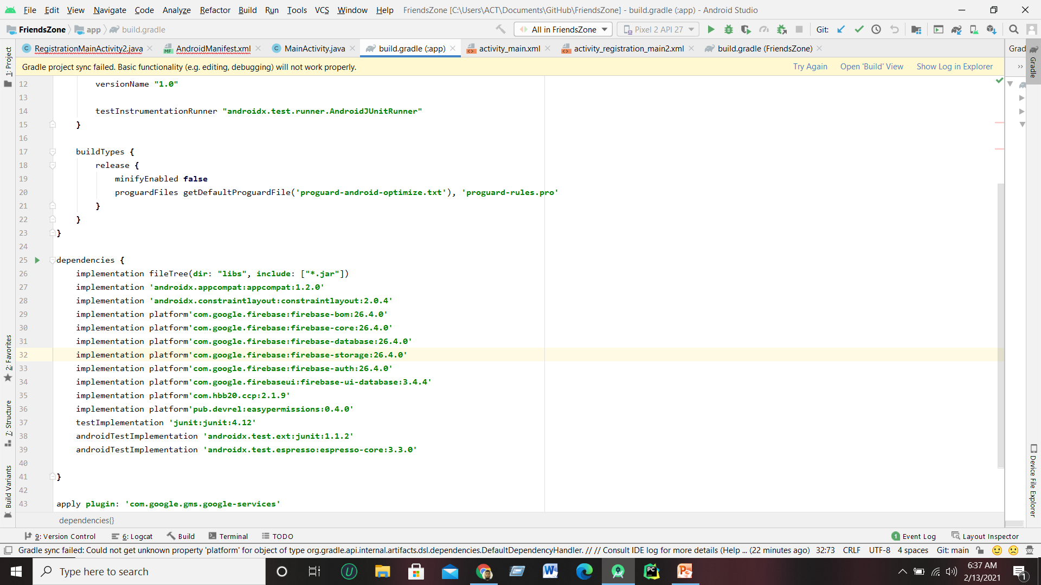
Build.gradle
Project Name: Friends Zone App Page: 07

Slide 8
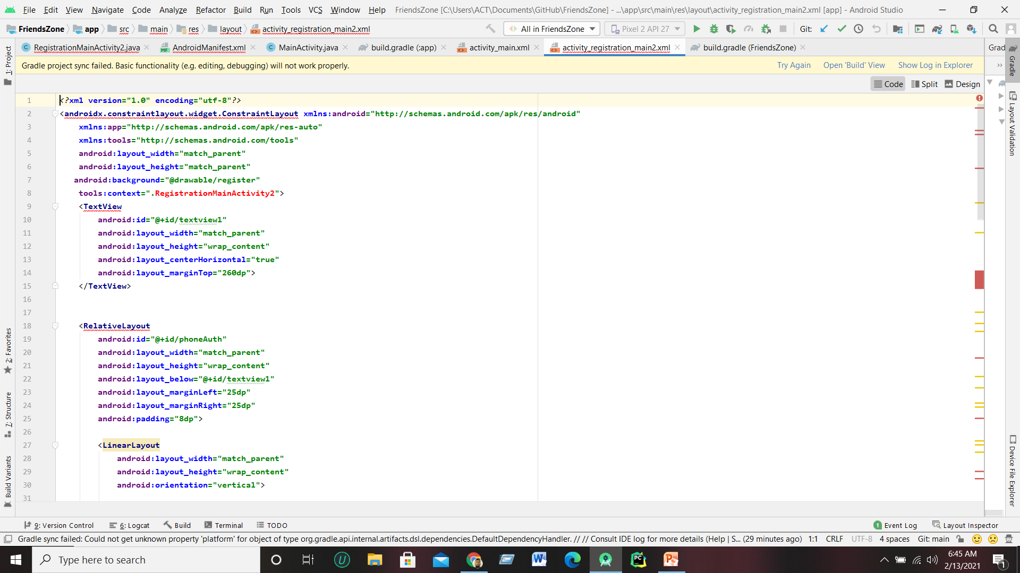
Important parts of program
Activity_registration main2.xml
Project Name: Friends Zone App Page: 08

Slide 9
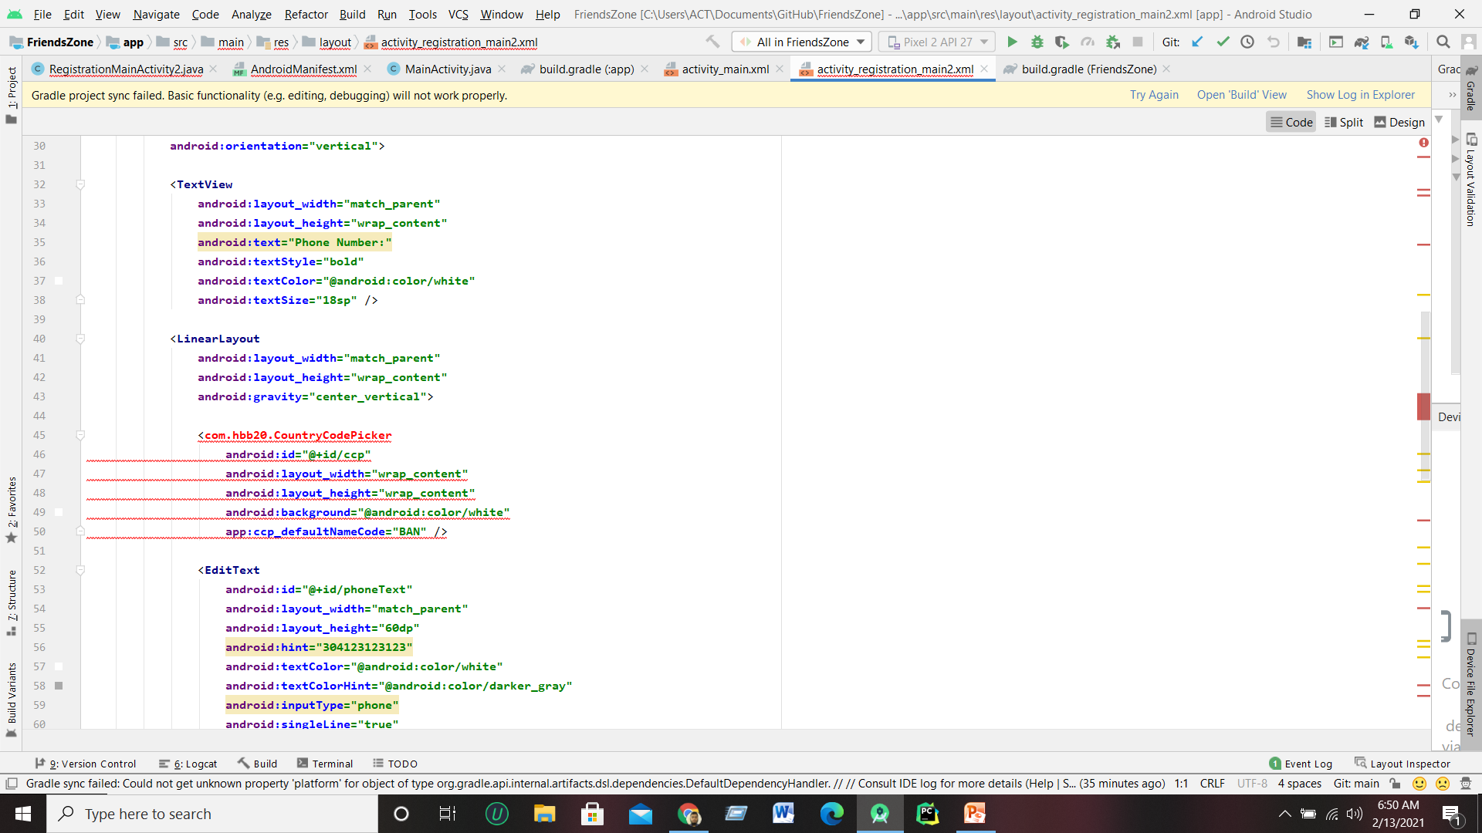
Important parts of program
Activity_registration main2.xml
Project Name: Friends Zone App Page: 09

Slide 10
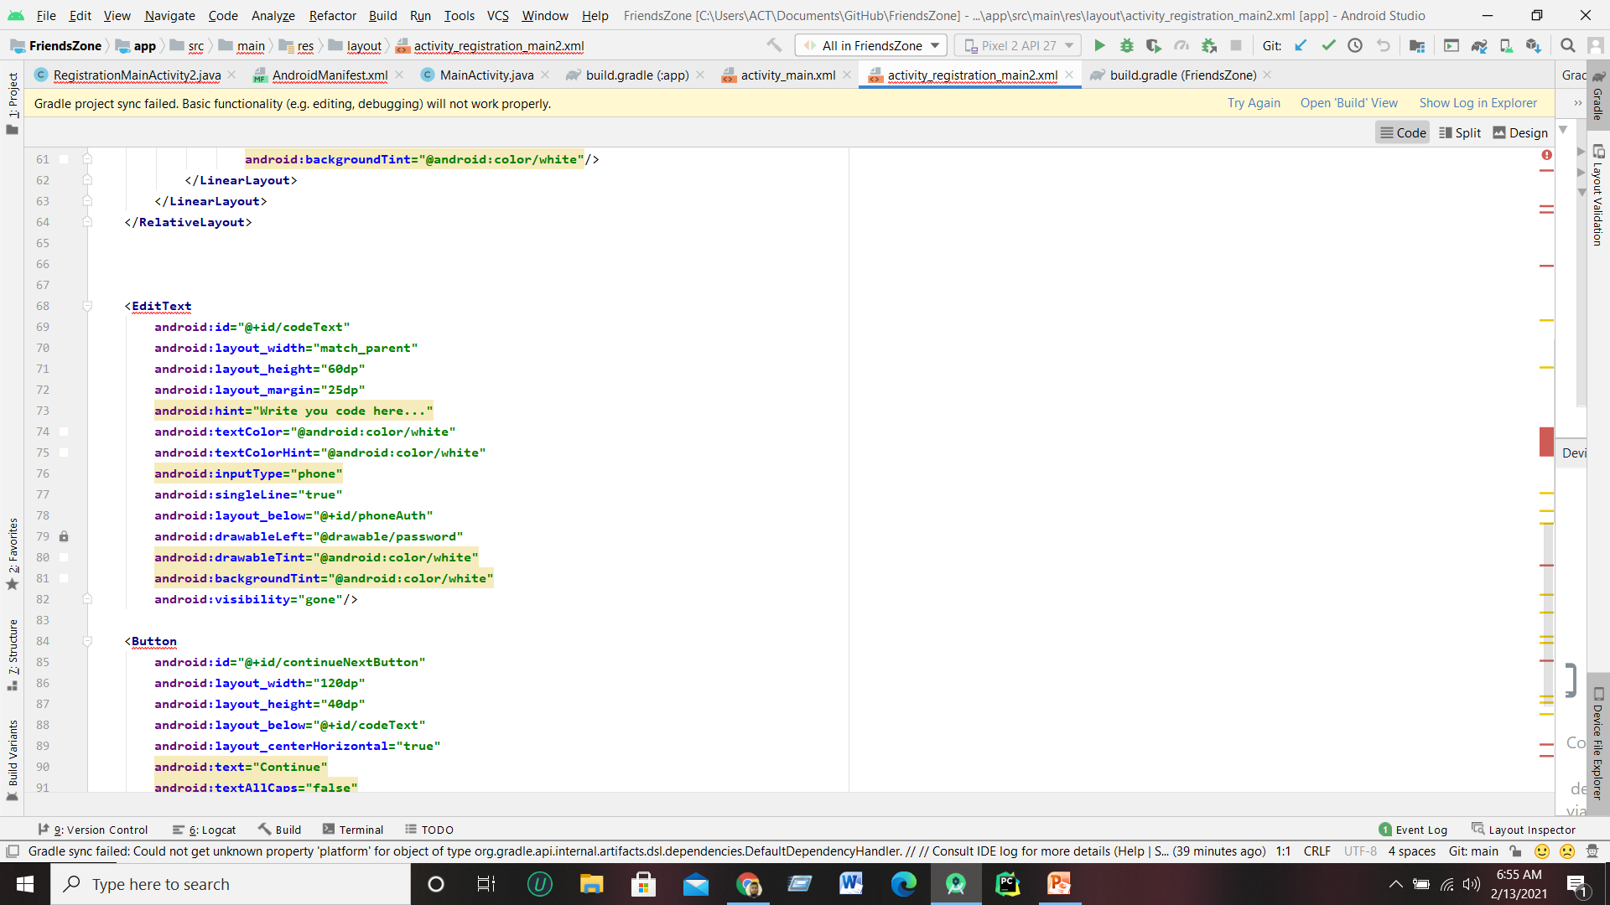
Activity_registration main2.xml
Project Name: Friends Zone App Page: 10

Slide 11
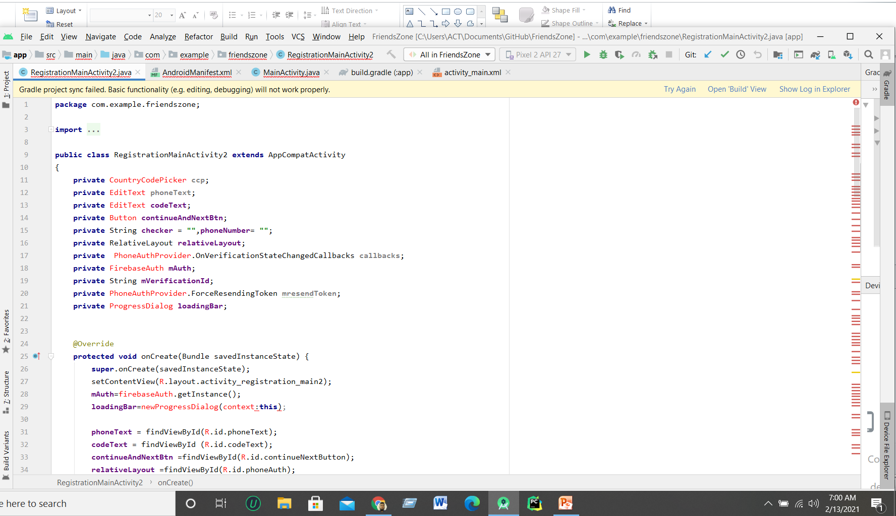
Registration_MainActivity2.java
Project Name: Friends Zone App Page: 11

Slide 12
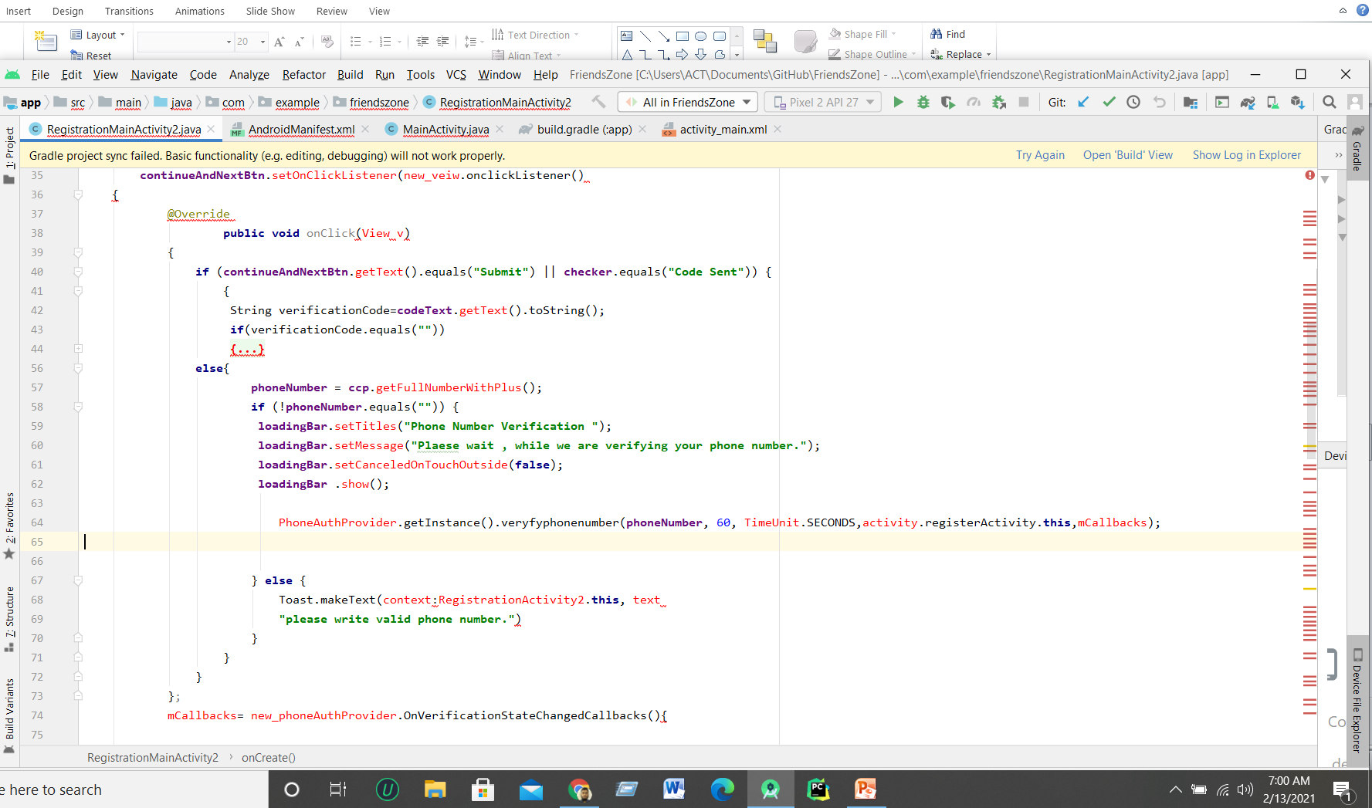
Registration_MainActivity2.java
Project Name: Friends Zone App Page: 12

Slide 13
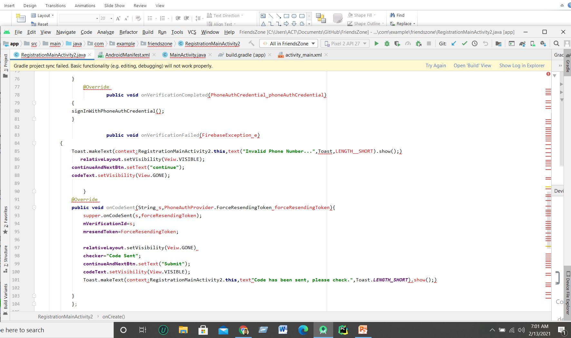
Registration_MainActivity2.java
Project Name: Friends Zone App Page: 13

Slide 14
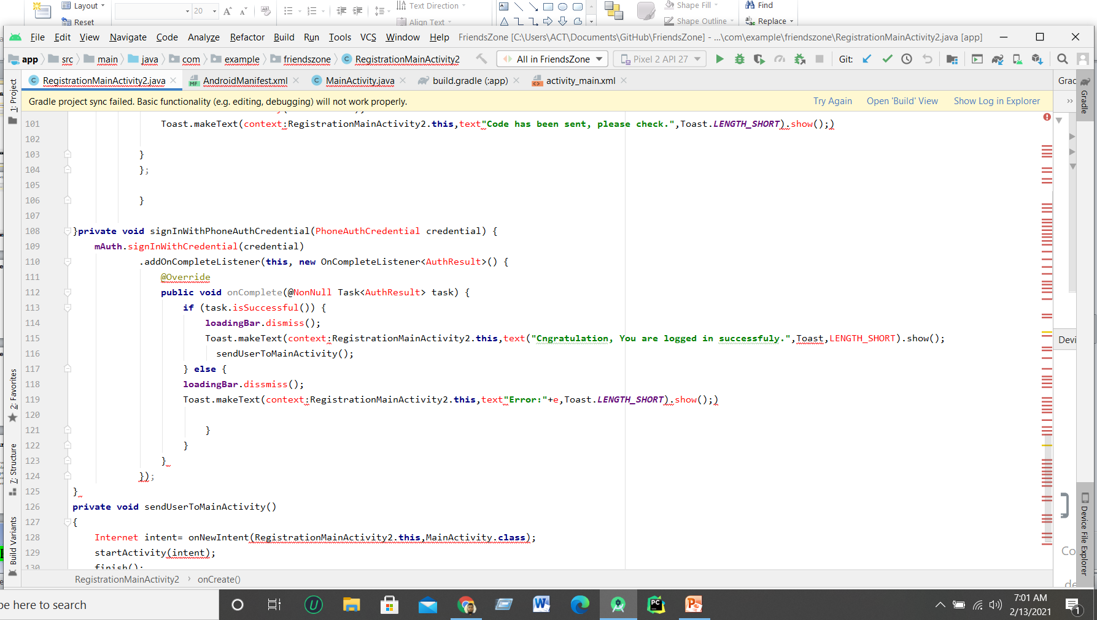
Registration_MainActivity2.java
Project Name: Friends Zone App Page: 14

Slide 15
Future Plan
In future I will improve the section of friend request & confirm that’s why any one send request & confirmed. I will also improve chat option .
Project Name: Friends Zone Ap Page: 15

Slide 16
THANK YOU
Project Name: Friends Zone App Page: 16

